Slide 1
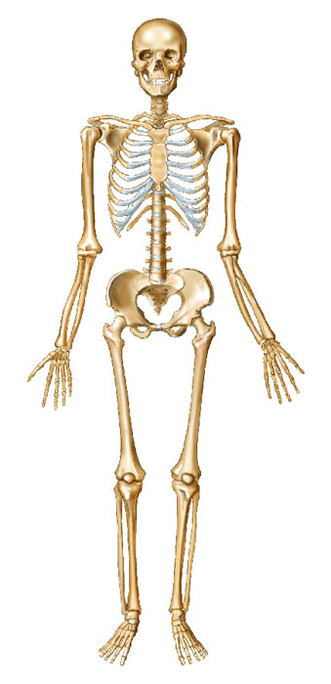
Daily Review
Vocabulary
Vital organ: An organ you cannot live without eg. brain, lungs, heart
Skull
Clavicle
Axial Skeleton and Appendicular Skeleton
The skeleton can be divided into two general parts:
The axial skeleton – bones that protect vital organs
The appendicular skeleton – bones that allow movement
Classify the following bones as parts of the axial skeleton or the appendicular skeleton:
Ribs Femur Radius Skull
Pelvis Clavicle Vertebrae Fibula
Ribs
Humerus
Vertebrae
Radius
Pelvis
Ulna
Femur
Patella
Tibia
Fibula

Slide 2
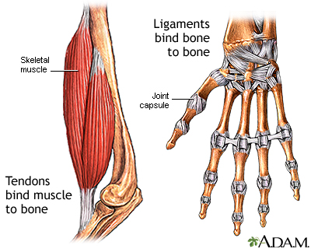
Daily Review
CFU 1
How are tendons and ligaments similar?
Tendons and Ligaments
Tendons and ligaments are tough bands of tissue.
Tendons connect muscles to bones.
Ligaments connect bones to other bones.
CFU 2
How are tendons and ligaments different?
CFU 3
Identify the tendon and the ligament in the diagram. Explain your choice.
B
A

Slide 3
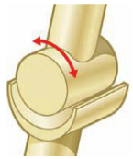
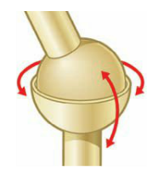
Daily Review
CFU 1
How does a hinge joint move?
Types of Joints
Hinge joints only move backwards and forwards (like a door hinge)
Ball and socket joints allow movement in all directions: one bone has a ball shaped end that fits into another bone’s cup shaped end
CFU 2
How do ball and sockets joints allow movement in all directions?
CFU 3
What type of joint is the shoulder? Explain your choice.

Slide 4
Circulatory System Year 8 Science

Slide 5
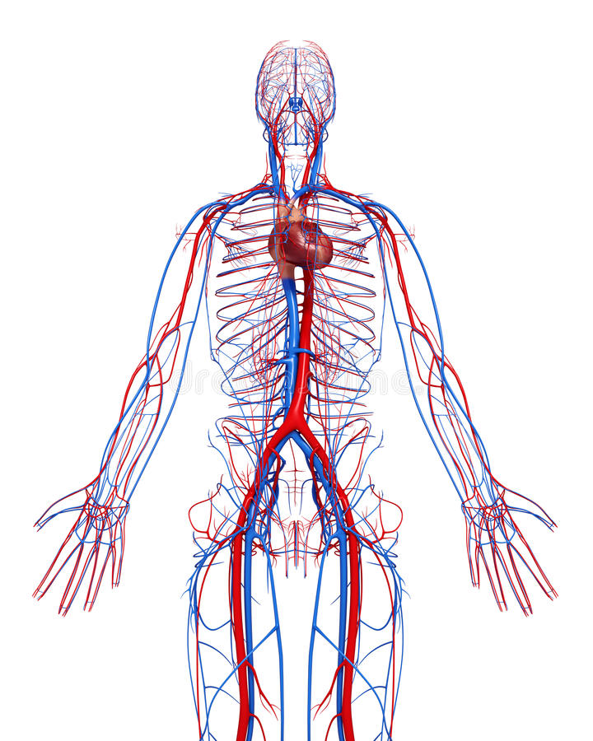
Learning Objectives
CFU
What do you need to know about the heart?
Identify the organs of circulatory system and their functions
Describe the structure of the heart
Describe the path blood takes through the heart
Activate Prior Knowledge
There are many systems of organs in the human body.
Think, Pair, Share: What are the organ systems in the human body?
Think, Pair, Share: Name two organs in the circulatory system.

Slide 6
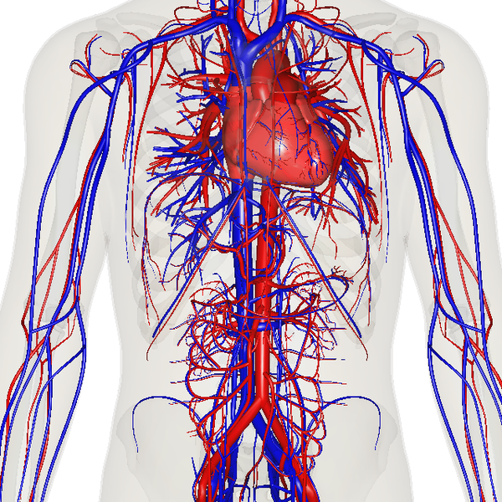
Concept Development
CFU 1
What does the circulatory system do?
The Circulatory System
The circulatory system is a group of organs which work together to transport gases, nutrients, waste products and heat around the body.
This process is known as circulation.
CFU 2
What is circulation?
CFU 3
Would you expect to find sugars in your blood? Why or why not?

Slide 7
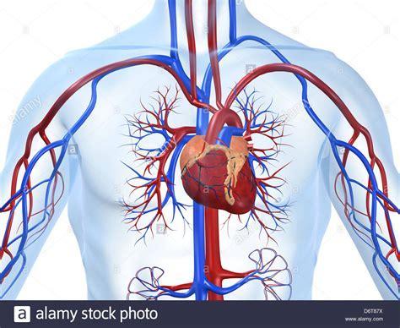
Concept Development
CFU 1
What are the three organs of the circulatory system?
The Circulatory System
There are three organs in the circulatory system:
Heart – a pair of pumps made of cardiac muscle
Blood vessels – tubes which allow the movement of blood throughout the body
Blood – a liquid organ that carries oxygen, nutrients and water to cells, and removes carbon dioxide and waste from cells
CFU 2
What is the function of blood vessels?
CFU 3
Via the blood, oxygen is carried to the cells and carbon dioxide away from the cells. Why is this important?

Slide 8
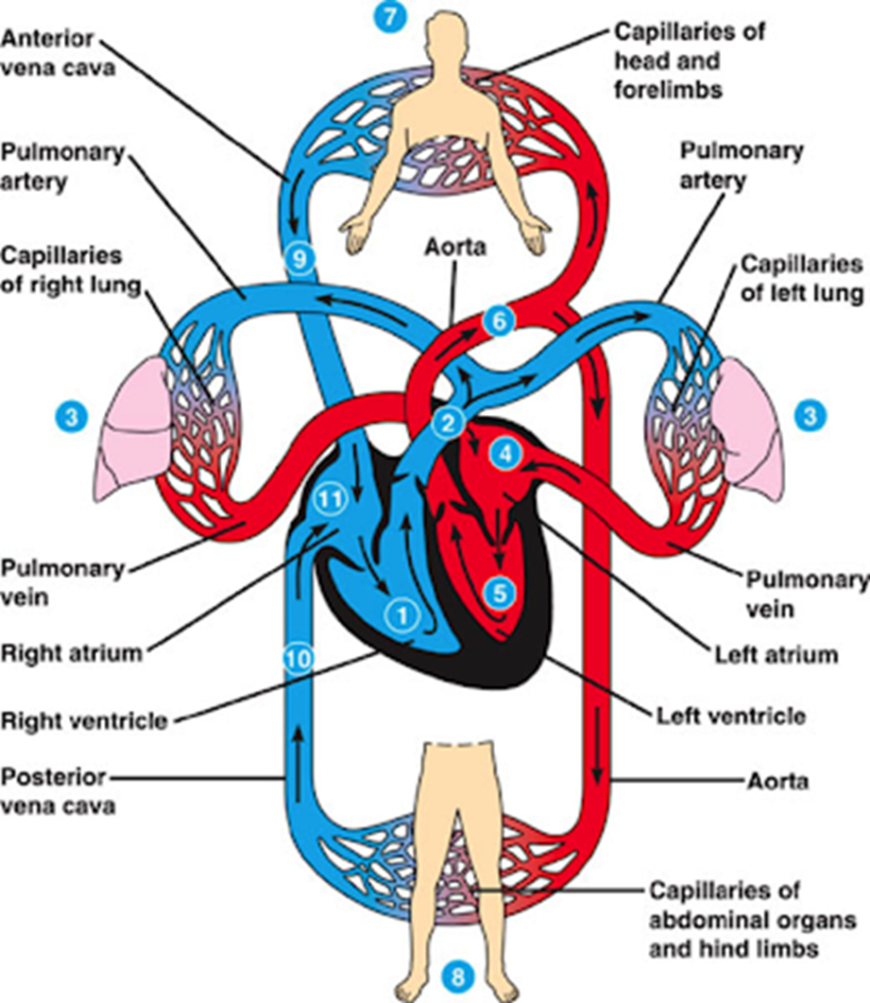
Concept Development
CFU 1
Where is the heart located?
CFU 2
How does the heart move the blood around the body?
The Heart – Function
The heart is a muscular pump located slightly to the left of the middle of the chest, behind the sternum (breastbone).
It is constantly contracting and relaxing, which moves the blood and its contents around the body.
The heart is connected to arteries that carry oxygenated blood (red) to the body’s cells, and veins that carry deoxygenated blood (blue) back to the heart.
CFU 3
What colour represents oxygenated blood?
CFU 4
What colour represents deoxygenated blood?

Slide 9
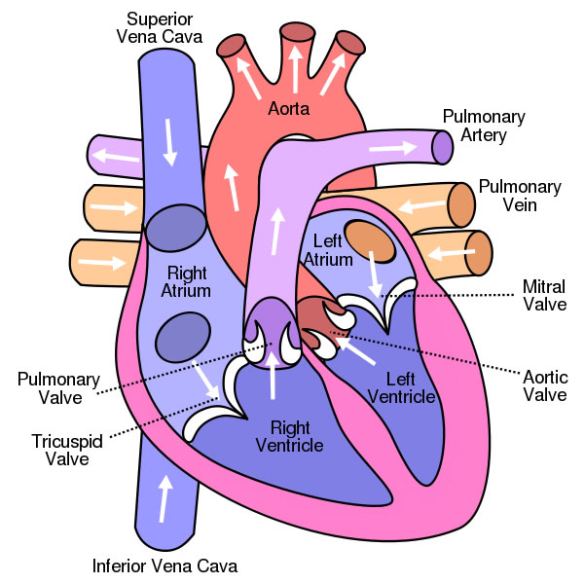
Concept Development
CFU 1
How many chambers does the heart have?
CFU 3
What is the function of the pulmonary vein? Explain how it is different to pulmonary artery.
Parts of the Heart
The heart has four chambers:
Two atria (singular: atrium)
The top two chambers, where blood enters
Two ventricles
The bottom two chambers, which blood is pumped out of
The heart also has four main blood vessels:
Pulmonary Artery – sends blood to the lungs
Pulmonary Vein – receives blood from the lungs
Aorta – sends blood to the body
Vena Cava (superior and inferior) – receives blood from the body
CFU 2
Which blood vessels carry blood away from the heart?

Slide 10

Skill Development
CFU 1
How does deoxygenated blood enter the heart?
CFU 2
Which valves prevent back-flow in the right atrium and right ventricle?
The Heart – Function:
Deoxygenated blood from the body enters the heart through the vena cava.
It enters the right atrium, and is pumped into the right ventricle.
The deoxygenated blood then is pumped out to the lungs through the pulmonary artery.
Valves (tricuspid and pulmonary) prevent blood flowing back the wrong way.
CFU 3
Where does the deoxygenated blood go after leaving the right ventricle? How does it get there?

Slide 11
Skill Development
CFU 1
How does oxygenated blood enter the heart?
CFU 2
What role do the valves play in the heart?
The Heart – Function:
Oxygenated blood from the lungs enters the heart through the pulmonary vein.
It enters the left atrium, and is pumped into the left ventricle.
The oxygenated blood is then pumped out to the body through the aorta.
Valves (mitral and aortic), prevent blood flowing back the wrong way.
CFU 4
What is the difference between the left and right sides of the heart?
CFU 3
How does the blood enter the body from the heart?

Slide 12
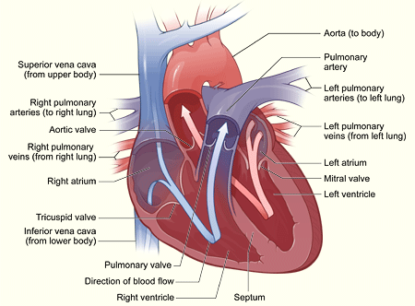
Skill Development / Guided Practice
Describing the path of blood through the heart
1. Identify the starting point on the diagram 2. State whether the blood is oxygenated (red) or deoxygenated (blue) 3. Follow the arrows through the different parts of the heart until the blood exits the heart
Describe the path of blood from the right ventricle.
The deoxygenated blood in the right ventricle goes through the pulmonary artery to the lungs.

Slide 13
Skill Development / Guided Practice
Describing the path of blood through the heart
1. Identify the starting point on the diagram 2. State whether the blood is oxygenated (red) or deoxygenated (blue) 3. Follow the arrows through the different parts of the heart until the blood exits the heart
Describe the path of blood from the left ventricle.
The oxygenated blood in the left ventricle goes through the aorta to the body.

Slide 14
Skill Development / Guided Practice
Describing the path of blood through the heart
1. Identify the starting point on the diagram 2. State whether the blood is oxygenated (red) or deoxygenated (blue) 3. Follow the arrows through the different parts of the heart until the blood exits the heart
Describe the path of blood from the left atrium.
The oxygenated blood in the left atrium goes into the left ventricle, then through the aorta to the body.

Slide 15
Skill Development / Guided Practice
Describing the path of blood through the heart
1. Identify the starting point on the diagram 2. State whether the blood is oxygenated (red) or deoxygenated (blue) 3. Follow the arrows through the different parts of the heart until the blood exits the heart
Describe the path of blood from the vena cava.
The deoxygenated blood goes through the vena cava into the right atrium, then the right ventricle and goes to the lungs through the pulmonary artery.

Slide 16
Skill Development / Guided Practice
Describing the path of blood through the heart
1. Identify the starting point on the diagram 2. State whether the blood is oxygenated (red) or deoxygenated (blue) 3. Follow the arrows through the different parts of the heart until the blood exits the heart
Describe the path of blood from the pulmonary veins.
The oxygenated blood goes through the pulmonary vein into the left atrium, then goes into the left ventricle and goes out through the aorta to the body.

Slide 17
Relevance
Knowing how organs work together in a system and how the systems interact with each other will help you understand how the body works.
Understanding the structure and function of the circulatory system will help you understand how we get nutrients and oxygen to our cells.

Slide 18
Skill Closure
Name two substances the circulatory system carries around the body.
Skill Closure
For each section of the heart below, match it to its function.
Components Function
1 Pulmonary Vein A Deoxygenated blood from body travels to heart
2 Pulmonary Artery B Oxygenated blood from heart travels to body
3 Aorta C Deoxygenated blood from heart travels to lungs
4 Vena Cava D Oxygenated blood from lungs travels to heart
Skill Closure
Describe the path blood takes from the right atrium through the heart.

Slide 19
Independent Practice
Collect and complete a hard copy of the circulatory system worksheet.
Circulatory System
The organs of the circulatory system work together to maintain circulation within your body.
Circulation is the process of transporting gases, nutrients, waste products and heat around the body via the blood.
There are three organs in the circulatory system:
Heart – a pair of pumps made of cardiac muscle
Blood vessels – tubes which allow the movement of blood throughout the body
Blood – a liquid organ that carries oxygen, nutrients and water to cells, and removes carbon dioxide and waste from cells

